Slide 1

R³
^{(Reduce, Reuse, Recycle)}
Prototype Pitch
Patapsco Middle School - 6th Grade
Designed by: The RoboKnights
2017-2018
Harini Devireddy
Pragna Yalamanchili
Srinidhi Akella
Venya Karri

Slide 2
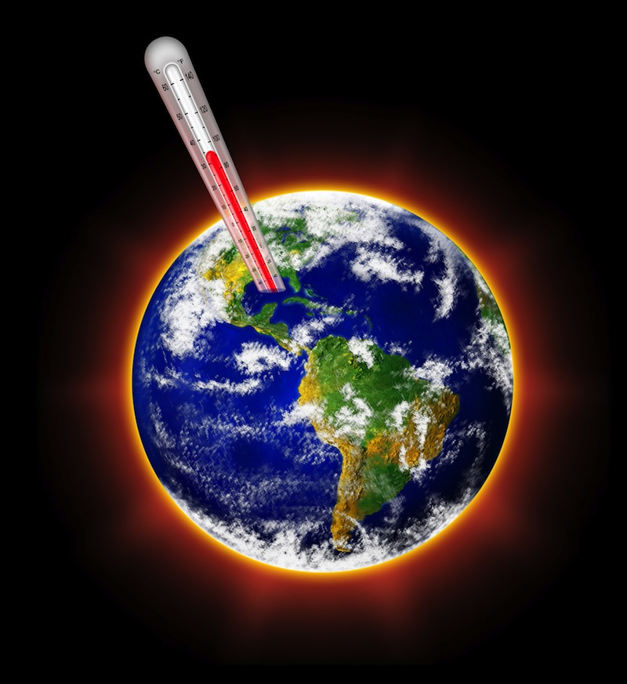
Problem Definition
A lot of recyclable items are being thrown into the trash and being sent to landfills everyday, this creates toxic chemicals that heat up the earth and contributes to global warming.
Another issue with recyclable items in landfills is that they don’t biodegrade quickly. In fact, it takes an average aluminum can takes 200-500 years to biodegrade.
Currently have no device that can restrict recyclable items from intermixing with the trash
Bottomline is inability to efficiently segregate recyclable items from trash causes environmental pollution and opportunity lost in saving energy

Slide 3
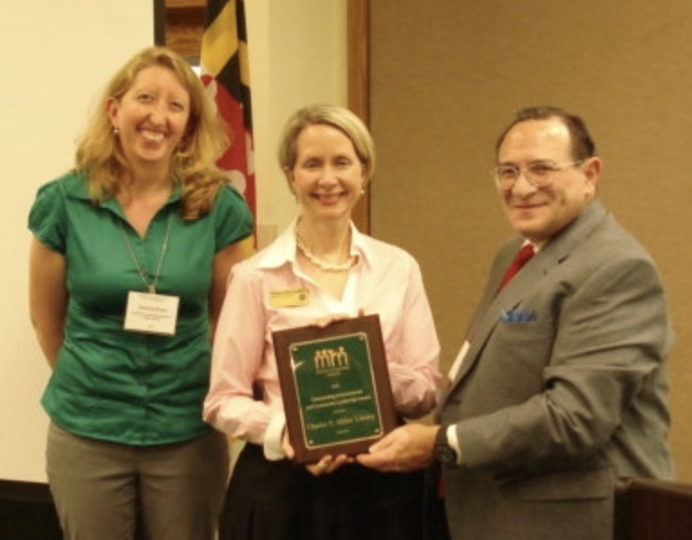
Client and Expectations
Client
Gemma Evans, the Recycling Coordinator, for Howard County Public Works.
Market
Howard County Residents (population of 313,414)
Current Impact
Toxic chemicals are leaching into the ground
Indirectly affecting climate change
Reduction in the amount of materials recycled and reused for other purposes
49.9% Diversion rate of materials being diverted from Alpha Ridge Landfill to a recycling facility
1.7% of recycled materials are made of metal

Slide 4
Requirements and expectations for our device
R³
Need a tool to identify recyclable items and restrict recyclable items to be intermixed with the trash
Efficient Proximity sensing of recyclable items
Needs to be weatherproof and avoid damage from trash inside the container
Needs to have display panel for friendly usability and buzzer prompting
Recyclables should be fed individually to container
Scope is limited for home usage - Needs further improvements for commercial usage

Slide 5
Current Solutions and their Weaknesses
Below are key findings based on our market research on existing solutions
There is no distinct product in market that can identify all types of recyclable items
None of the devices in the market, surprisingly is user friendly - don't have display, prompting and notification capabilities.
No device that can identify recyclable items that settled in trash bin, free flow to trash bin(W/O lid) and thrown into trash bin(with lid).
Bottomline is there is no efficient device that can restrict recyclable items from intermixing with trash.

Slide 6
Choices Made for Prototype
We considered the following solution choices for protype and selected Design Option 1
Option 1: A device to identify trash and recyclable items throwing into the trash bin with lid
Option 2: A device to identify recyclable items throwing into (free flow) the trash bin without lid
Option 3: A device to identify recyclable items from the settled items of the trash bin
Given defined timeline we considered the following capabilities for this iteration but it has foundational framework that can be extendable for future releases.
Identification of few selected recyclable items - metal detection scope only
Individual loading of the items in trash bin
LCD display for prompts along with buzzer
Lid auto open/close based on identification of items
Residential usage only
Temperature sensor
Notes:
Go into more detail about each point

Slide 7
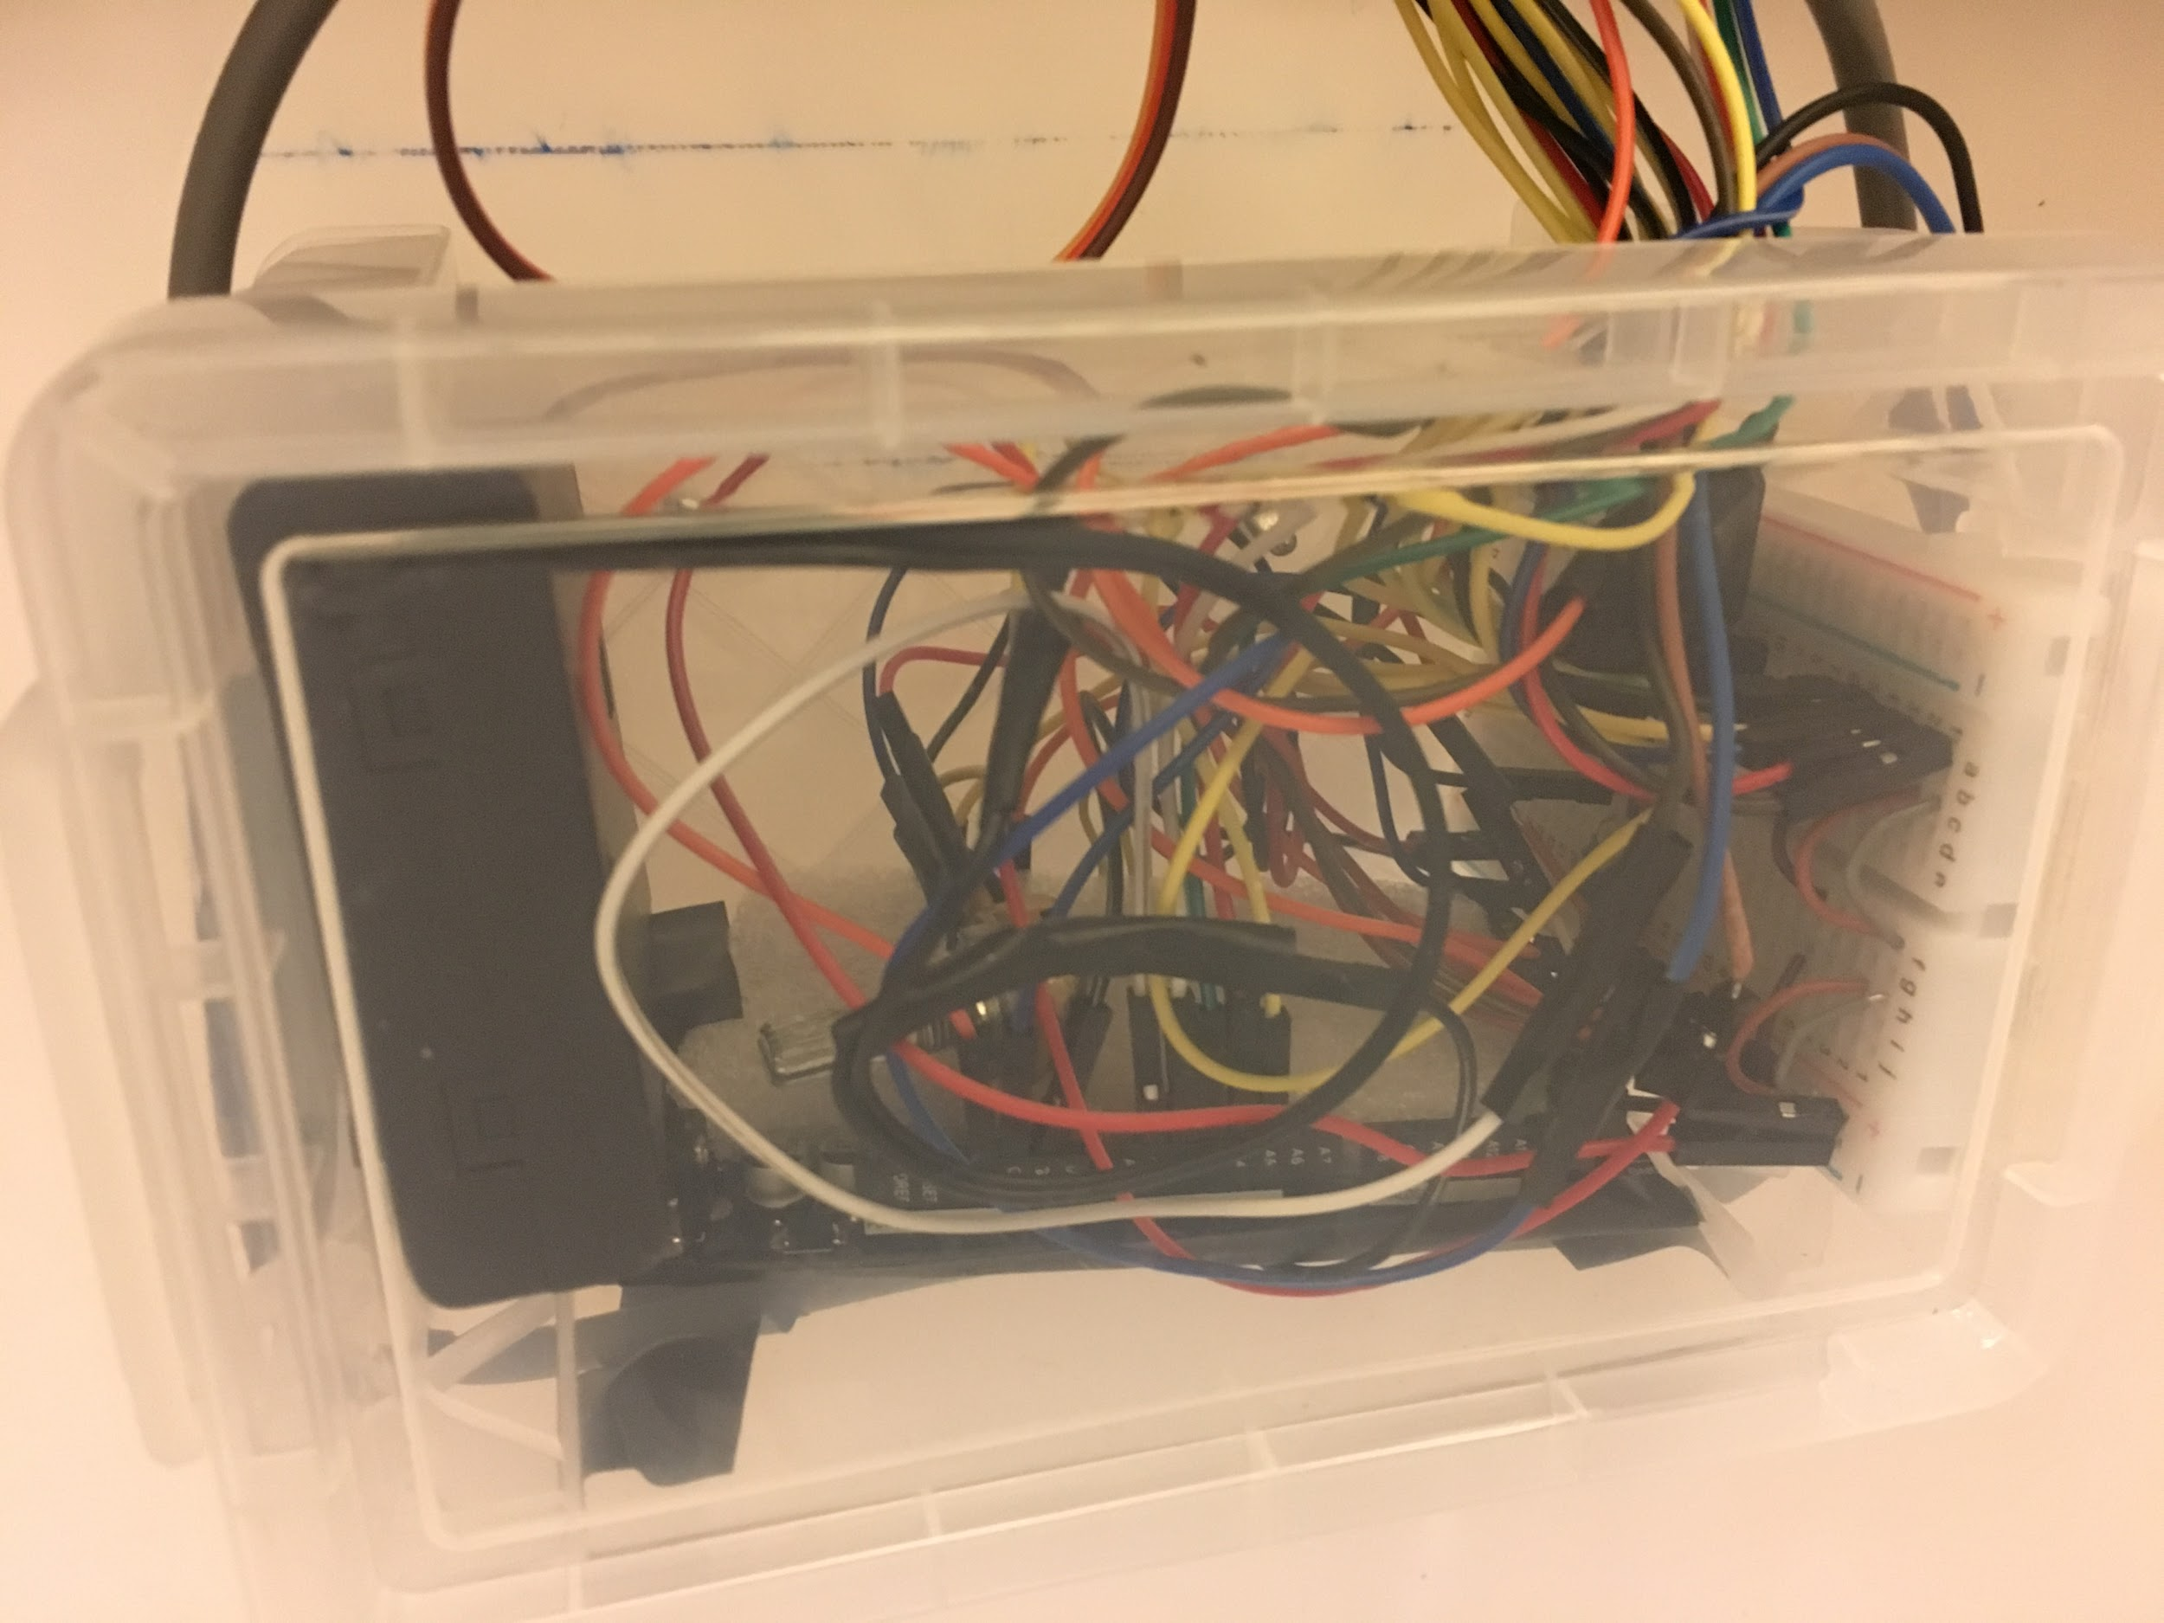
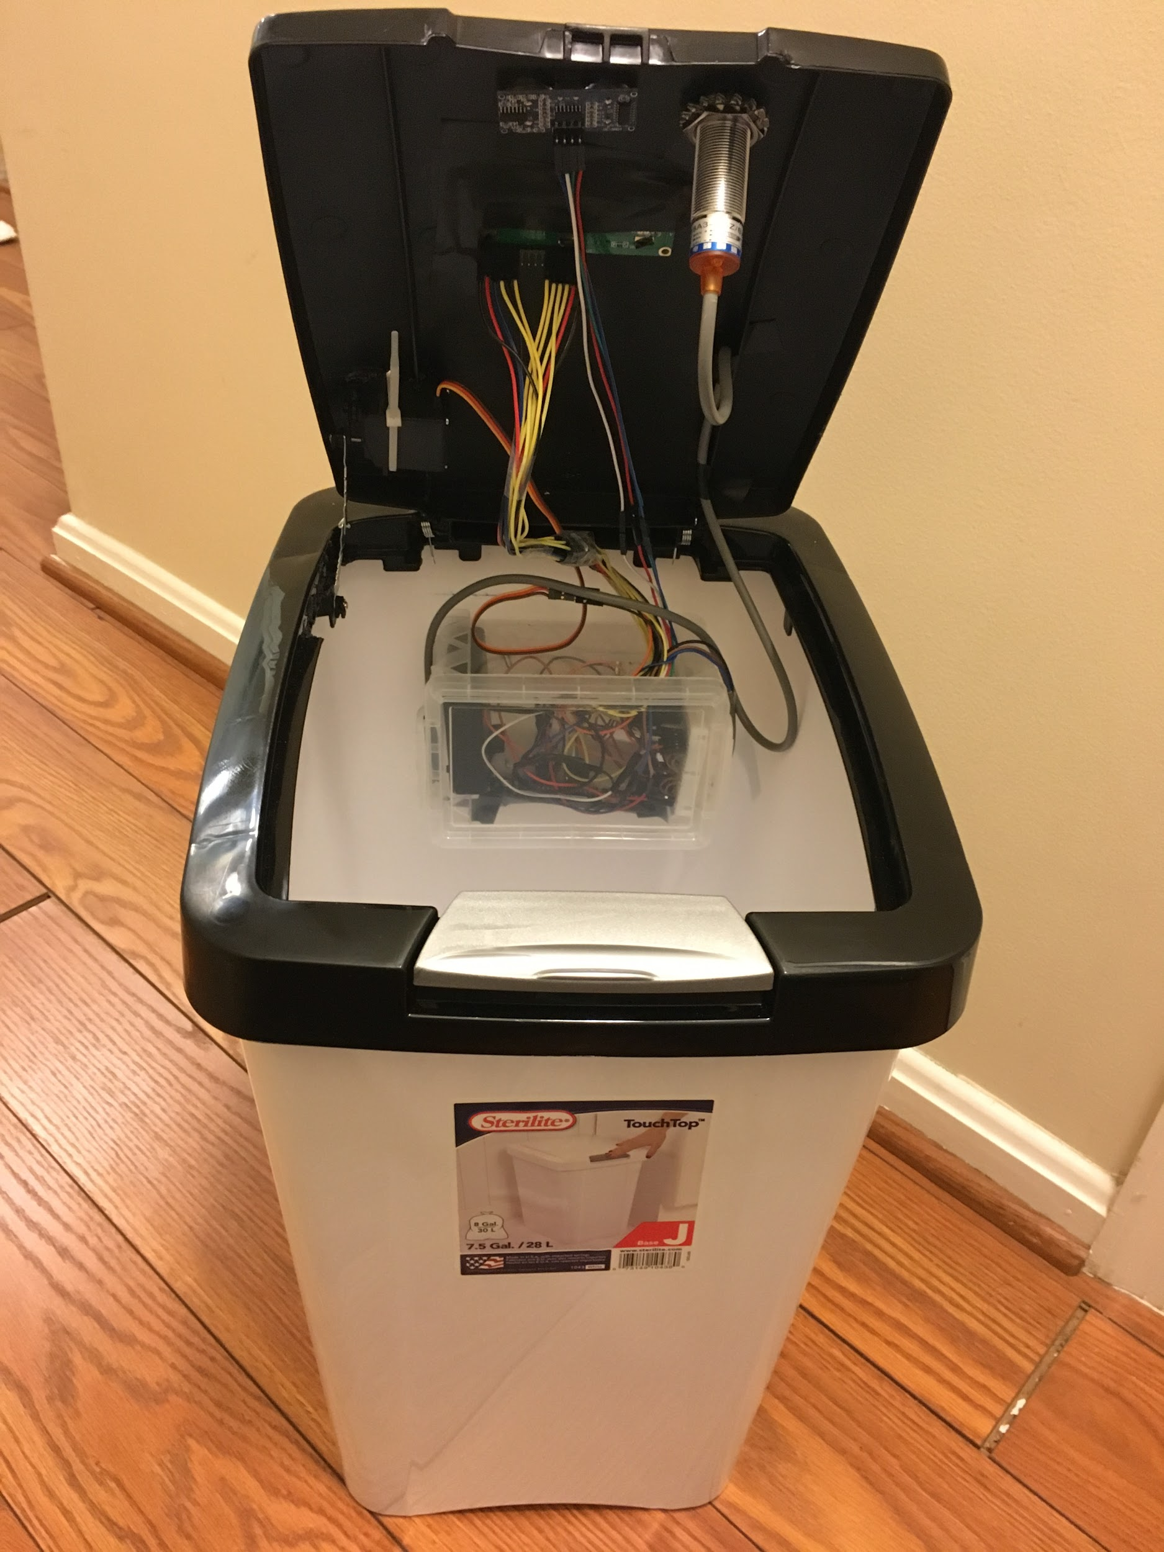
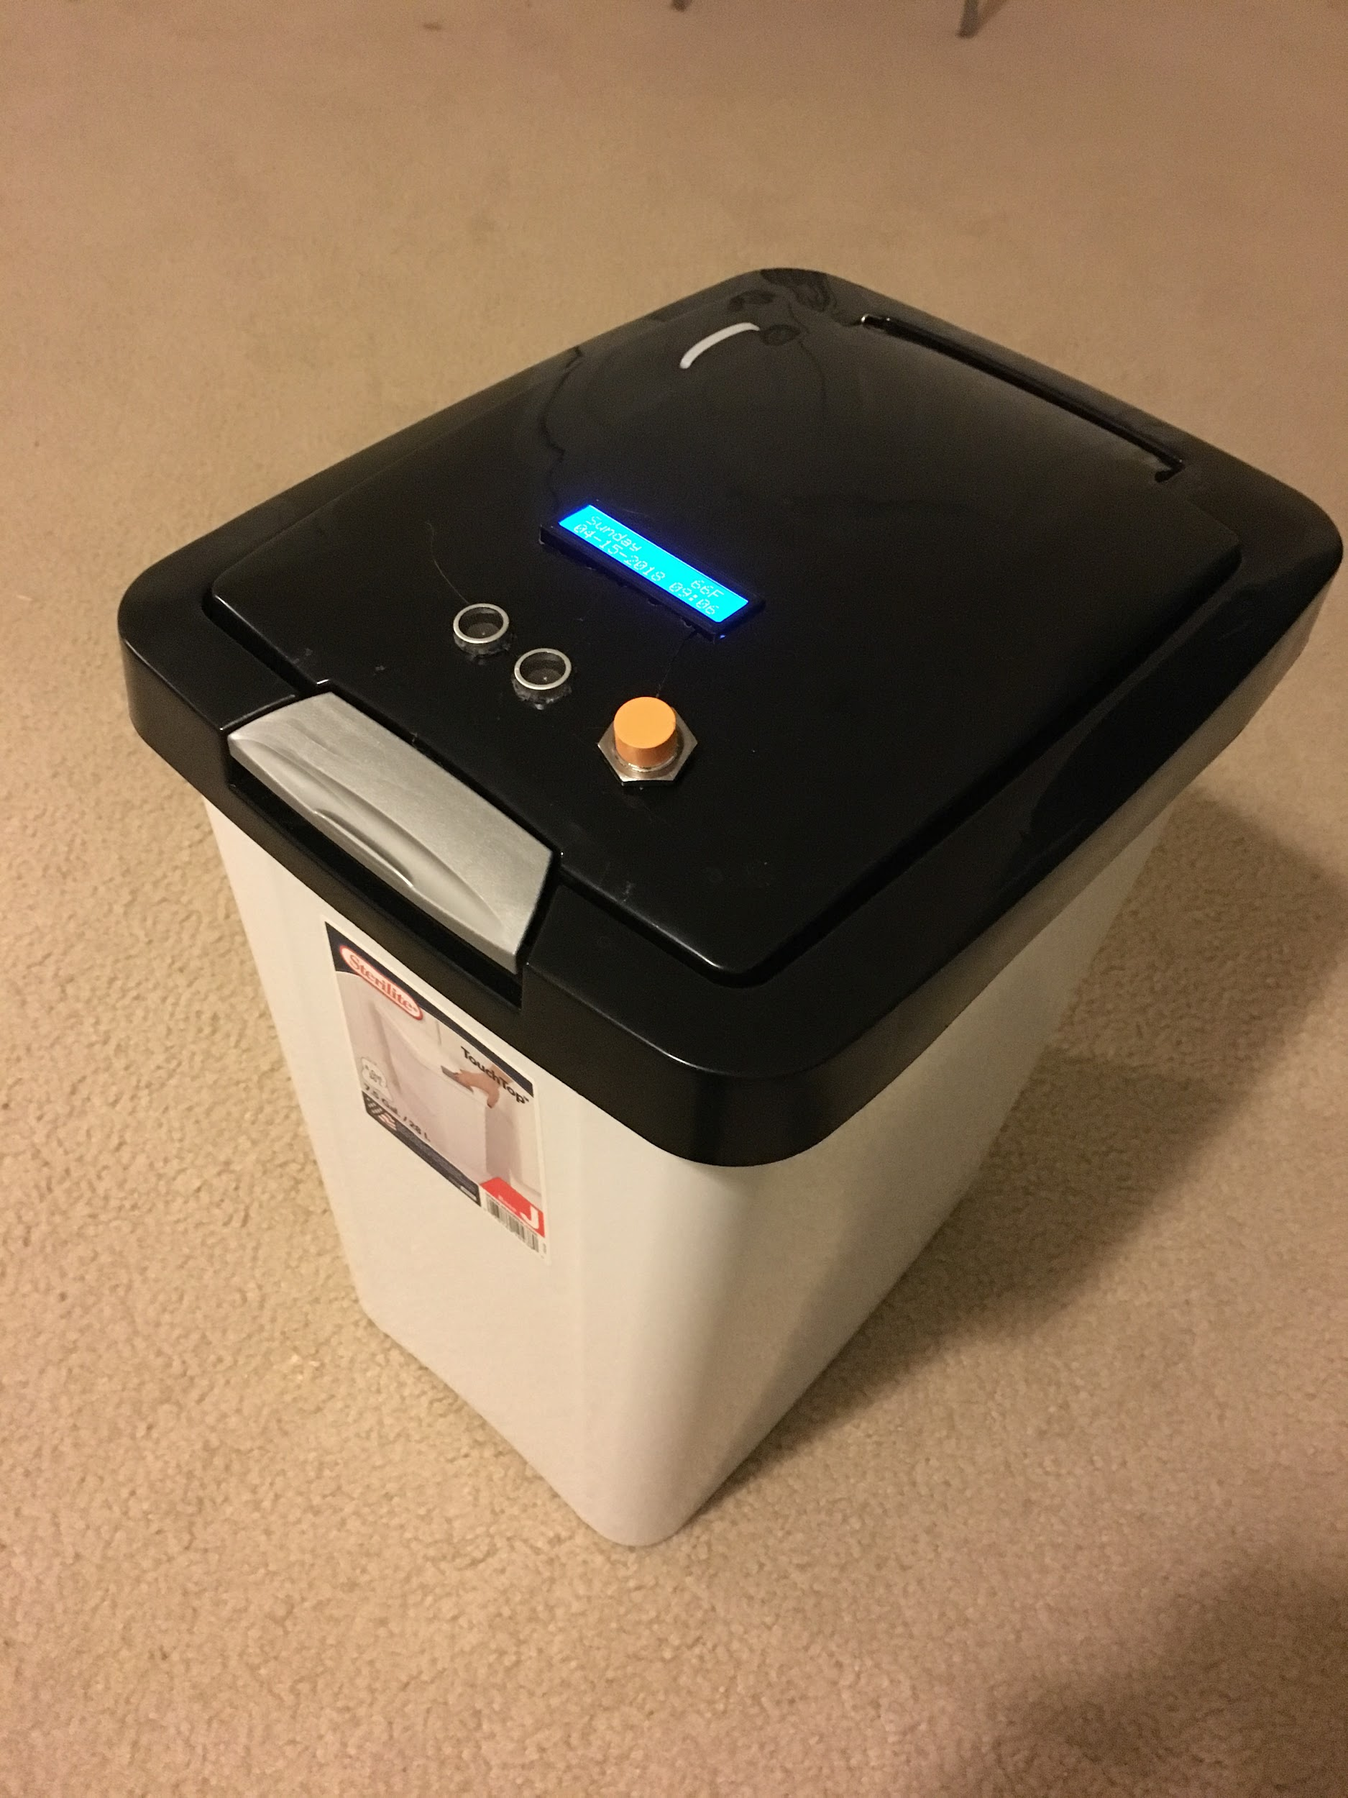
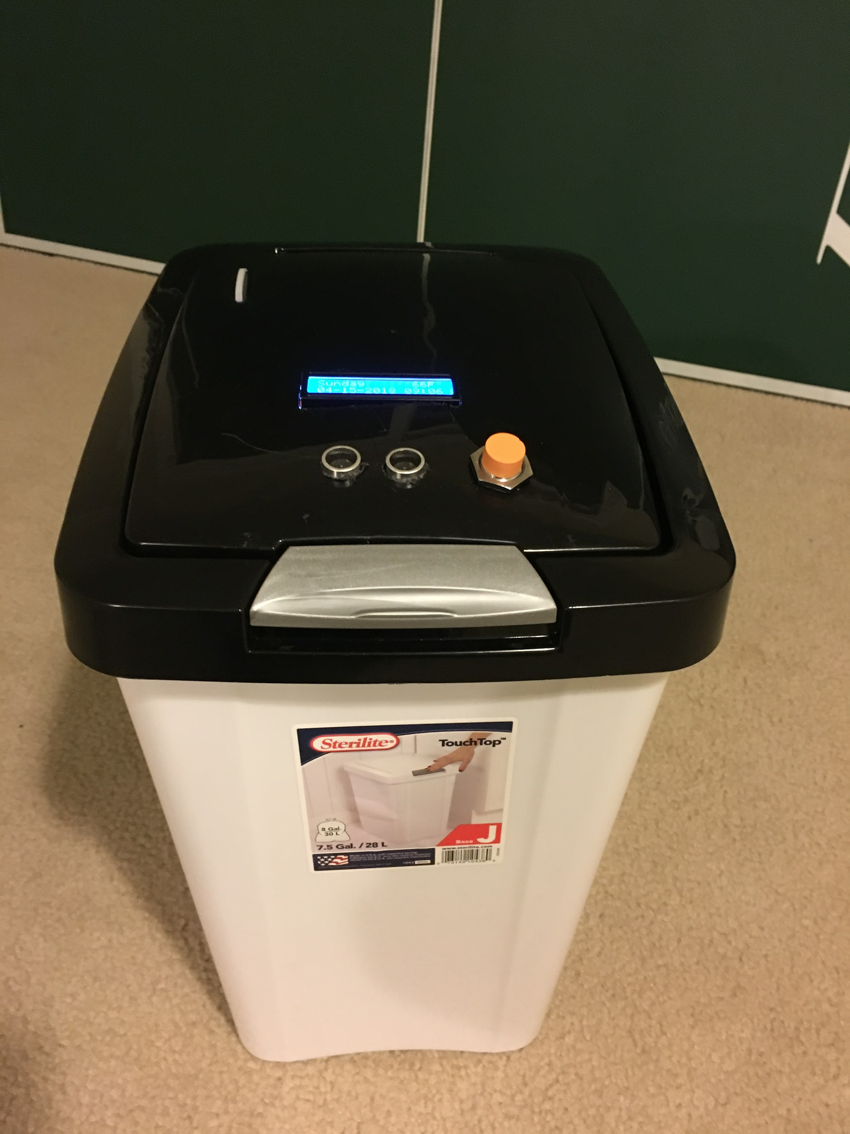
Prototype Demonstration

Slide 8
Advantages of Prototype
The device has foundational framework with focused capabilities but has potential to be fully extendable to meet broader diversified needs
Key Advantages
Minimizes intermixing of recyclable with trash in turn helps
Reduction of chemical toxic gases generation from Landfills
Increased Opportunity in recycling and energy saving
Real time clock (RTC) with day, date, time
Not expensive product
Scalability of product - Potential to increase the size of the trashcan without redesigning because the product is part of the lid of the trash can
Key Strengths
Supports metal detection to avoid intermixing with trash and provides recycle opportunity
The device is very user friendly - displays a LCD message and buzzer to prompt user to recycle the item
If the item is recyclable, the lid does not automatically open
Displays the temperature inside the trash can on LCD

Slide 9
Additional Advantages/Facts by R³
Below are the additional advantages by R³:
One coke can can run a television for 2 hours or power a light bulb for more than 4 hours
Our product had a 90% success rate and would increase the per household average of metal items recycled
Recycling metal items reduces greenhouse gas and carbon emissions compared to using new metal
Recycled metals can continue to be recycled and will not lose their structural value
92% of energy is saved using recycled aluminum.

Slide 10
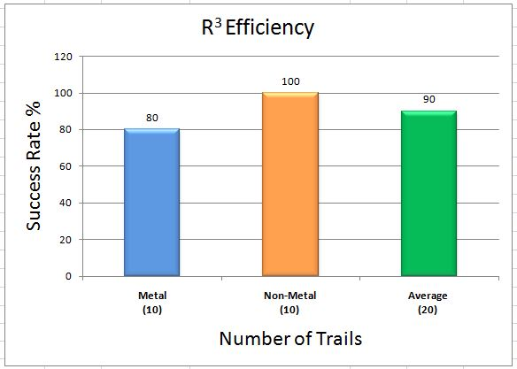
R³ Efficiency

Slide 11

Next Steps for Design that helps User
Enabling below capabilities are been considered for future enhancements for multi iteration releases for full blown product
Plastic, cardboard, paper and glass sensor are must have capabilities
Notification to user’s phone with recyclable data is nice to have future
Extend product capabilities from residential to commercial usage.
Monthly reports to user telling them how much they have recycled
Temperature sensor can be used to detect temperature over 80 degrees Fahrenheit to notify user with a message on LCD to empty trash from the bin

Slide 12

Any Questions?

